Slide 1

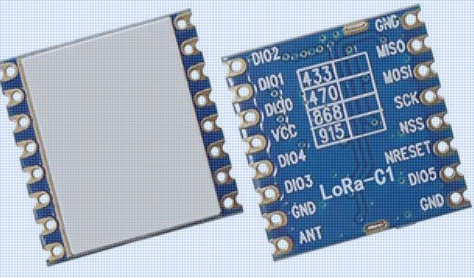
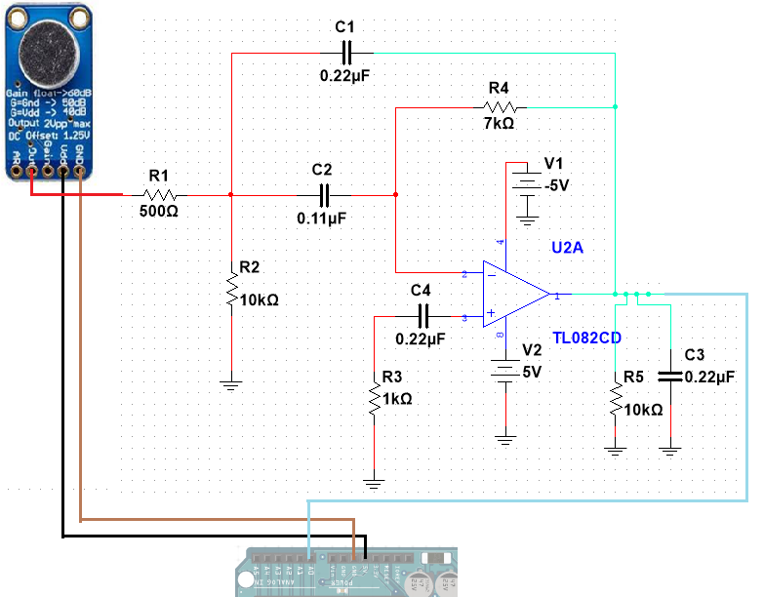
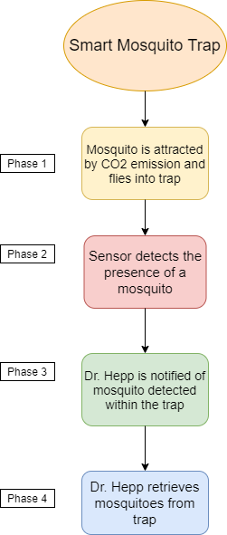
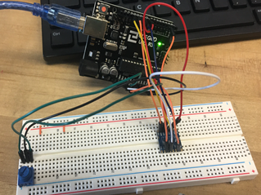
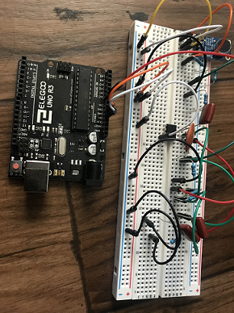
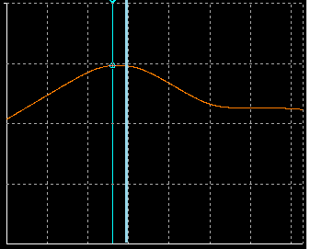
Smart Mosquito Trap: Detection
Heather Melville, Abdulrahman Almutairi, Saud Aljouhar, Chongxiang Cui
The School of Informatics, Computing, and Cyber Systems, Northern Arizona University, Flagstaff, AZ 86011
Abstract
Methods
Transmission:
To transmit the detection signal of the mosquito inside the trap we used a LoRa transceiver that is equipped with a long-range modem allowing us to transmit the detection data through its ultra-long spread spectrum communication capabilities.
The purpose of our project is to take an existing mosquito trap and give it ‘smart’ capabilities. These ‘smart’ capabilities consist of detecting when a mosquito has entered the trap and transmit that detection signal back to Dr. Crystal Hepp and her research team’s lab located in Flagstaff, Arizona. This will extend the life cycle of the trap without human interference.
Detection:
To detect the mosquito within the trap we used a circuit which implemented:
MAX9814 Microphone Amplifier
A bandpass filter using TL082 Op. Amp.
MAX865 Charge Pump
Arduino Zero Microcontroller
The Microphone Amplifier was used to receive the sound of the mosquito’s wing beats, which fed through the bandpass filter in order to filter the specific frequency belonging to the mosquito that Dr. Hepp focused her research on. The Charge Pump was necessary due to the Arduino Zero not being able to supply a negative voltage to power the Op. Amp.
Figure: LoRa 1276 module chip wireless transceiver
Dr. Crystal Hepp and her team are collecting mosquitoes to monitor various viruses that are transmitted by them such as West Nile Virus.
Figure: Flowchart of Smart Mosquito Trap
Figure: Schematic of Detection Circuit
Figure: Setup of LoRa transmission using an Arduino
Testing & Results
Transmission:
Using two LoRa wireless transceivers and an Arduino microcontroller we setup the circuit and tested the transmission using code provided by the Arduino libraries. Through the code we were able to send a signal from one LoRa device to another. The results were viewed on the monitor showing the message, “LoRa Sender” and the other device showing values on the monitor. The circuit was tested only from a 20-foot range.
Conclusion
Detection:
The bandpass filter was constructed and simulated using Multisim and we were successful in simulating the frequency range for the specific mosquitoes that will be trapped.
Due to the unforeseen circumstances such as the world crisis, failed prototypes and testing, more testing and merging of subsystems is needed to fully complete the project. As it stands, the project has been successful in testing the capabilities and implementation of the Microphone Amplifier, the simulation of the bandpass filter through Multisim and the transmission of a signal using a LoRa transceiver and two Arduino over a short-range distance.
Figure: Detection Circuit without Charge Pump
Due to the world crisis and delay of parts, the microphone amplifier was tested by itself through the Arduino. Expected results were received with the voltage of the amplifier changing due to change in frequency.
Acknowledgements
Figure: Plot of Bandpass filter simulated range of ~400Hz to ~850Hz
The team would like to acknowledge: Dr. Crystal Hepp, our client, Chase Ridenour, liaison to our client, Dr. Kyle Winfree, professor and advisor, Julie Heynssens, mentor.

